Slide 1
Using data augmentation to address class imbalance in predicting MBTI personality type based on online text
05/14/21 Project Checkpoint 2
CORONIA | LEYESA | LOPEZ
Notes:
Notes:
It’s not clear yung “multi-class” and “multi-label” -- explained.
This class imbalance -- ito yung i-babalance niyo; peperform data augmentation
Synonym replacement
In methodology, for example -- yung top 4, i-truncate siya to 1000. The rest would be data augmentation
Overfitting magiging risk if masyadong synthetic data
If maraming candidate for removal, then pwede
Y-axis should be class, not type
Pwede i-apply both under- and over-sampling as long as within reason.
If criteria for removal are those with missing values.
If you’re focused with data augmentation, ano yung 2 types of data augmentation.
Clarify the data augmentation technique: “build and compare models using training steps with augmentation and without data augmentation”
Hindi valid (?) na meron or walang data augmentation na exam -- ML model mo aaralin mo. Di siya mag-o-optimize. Yung plot mo for cost function -- minimum value shallow.
Recommendation: build and compare models
Mas okay na yong 4 models EACH technique USING DATA AUGMENTATION
Mas okay na kahit yon na.
RRL: kahit 1 paragraph lang yung mga semi-related.
Pinakadulo, ito lang yung alam namin: there are limited works that use text to identify MBTI type ganon ganon
Best if data processing stage. Input sa model.
Isama na sa report -- pero wag na lagay sa objective. For discussion purposes nalang na pag walang data augmentation, ito results.
2 techniques → change that shit to 2 tasks.
Figure 2 nalang yung teaser -- yung teaser ayusin. Basta highlight ng paper ganon
Format mali
Line 108 -- avoid parenthesis.
Any number < 10 dapat letters lang.
“On the other hand” is for comparison vs “On the one hand”
Line 204 - 208: included siya sa sentence -- basta yung listahan alam ko ano tinutukoy niya.
Work double-time sa data.

Slide 2
Problem Statement
We want to address class imbalance in the dataset via data augmentation techniques (which were adopted from computer vision).
We also want to explore between multi-class and multi-label text classification.
Notes:
methodology recommendation - top4 - truncate into 1000, rest data augmentation
balance the removal of data and augmentation of data
graphs - for consistency: y axis should be class
type indicator/letter - use one for consistency (we agreed on type indicator)
remove from objective - without data augmentation
change 2 techniques to 2 problems
change template to sig conf .tech (2 columns) - https://www.overleaf.com/latex/templates/association-for-computing-machinery-acm-sig-conference-proceedings-with-small-format-template/kxbkrwxkdgdh [???]
line 99 - 106 - avoid to conserve space
line 108 - avoid parenthesis
line 204 - 208 - include in sentence
figures and labels - include observations/patterns in caption

Slide 3
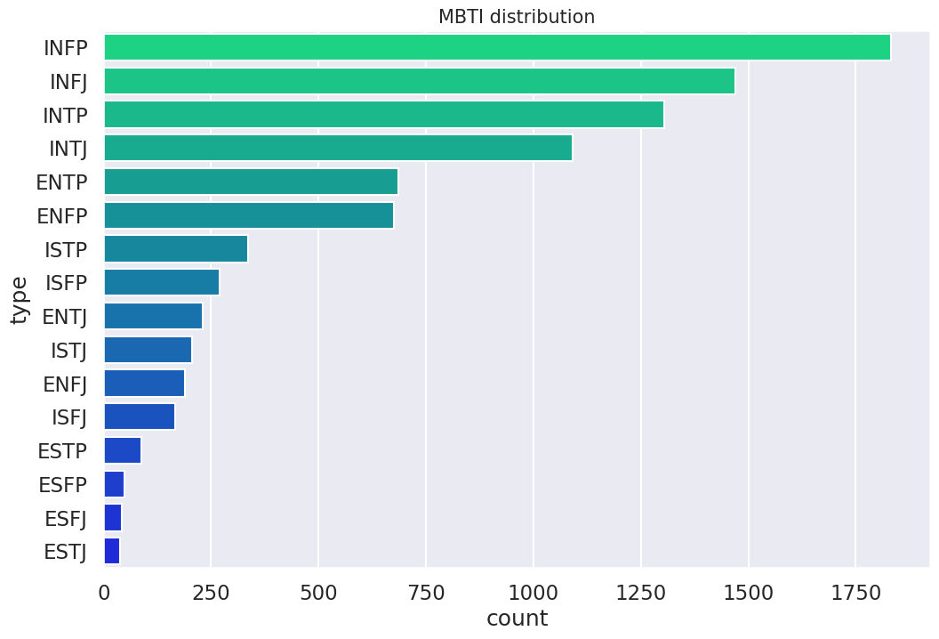
Problem Statement: Class Imbalance (MBTI Distribution)

Slide 4
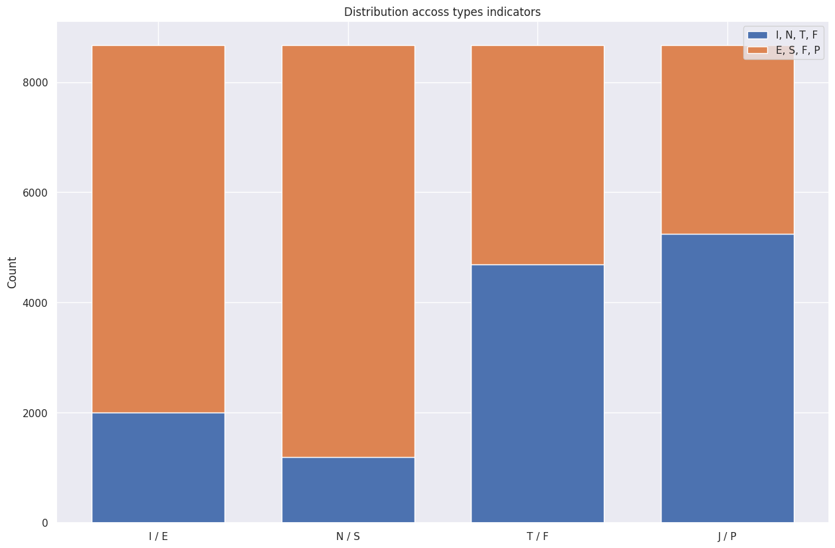
Problem Statement: Class Imbalance (Type Indicators)
I/E - Introvert-Extrovert
N/S - Intuition-Sensing
T/F - Thinking-Feeling
J/P - Judging-Perception

Slide 5
Objectives
Build and compare models between 2 techniques:
Performing text classification for all 16 classes.
Performing text classification per MBTI indicator.
Explore the effect of synonym replacement as a data augmentation technique for classification.

Slide 6
Progress
Data Preprocessing:
TF-IDF for input representation.
GloVe as basis for word similarity in synonym replacement (or substitution).
Substitution (synonym replacement) as data augmentation.
Models:
XG Boost.
Logistic Regression.
Multinomial Naive Bayes.
Support Vector Machines.

Slide 7
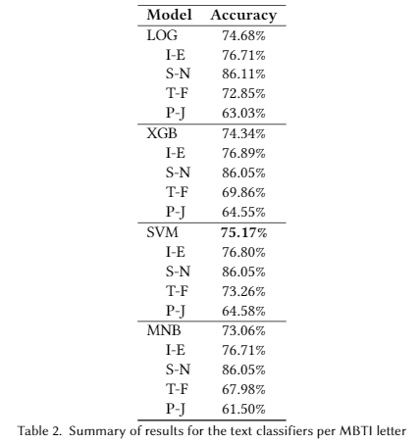
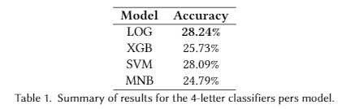
Progress: Preliminary Results (w/o Data Augmentation)
*LOG - Logistic Regression
XGB - XG Boost
SVM - Support Vector Machine
MNB - Multinomial Naive Bayes

Slide 8
Progress: Pending experiments
Data augmentation for the 2 techniques.
Would also include how many samples to add for under-represented classes, as well as which classes to augment with synthetic data.
Hyperparameter tuning and checking for bias & variance via stratified cross-validation.
We use stratified to ensure representation of all pertinent classes.
Notes:
https://medium.com/@mandava807/cross-validation-and-hyperparameter-tuning-in-python-65cfb80ee485
https://jakevdp.github.io/PythonDataScienceHandbook/05.03-hyperparameters-and-model-validation.html

